Slide 1
TAKE A MOMENT AND WRITE DOWN AN ANSWER TO THESE QUESTIONS:
What is science?
What is the purpose of science?
What is religion?
What is truth?
What do you see in these pictures?
Write down your thoughts.
Notes:
On a piece of paper with your name on it

Slide 2
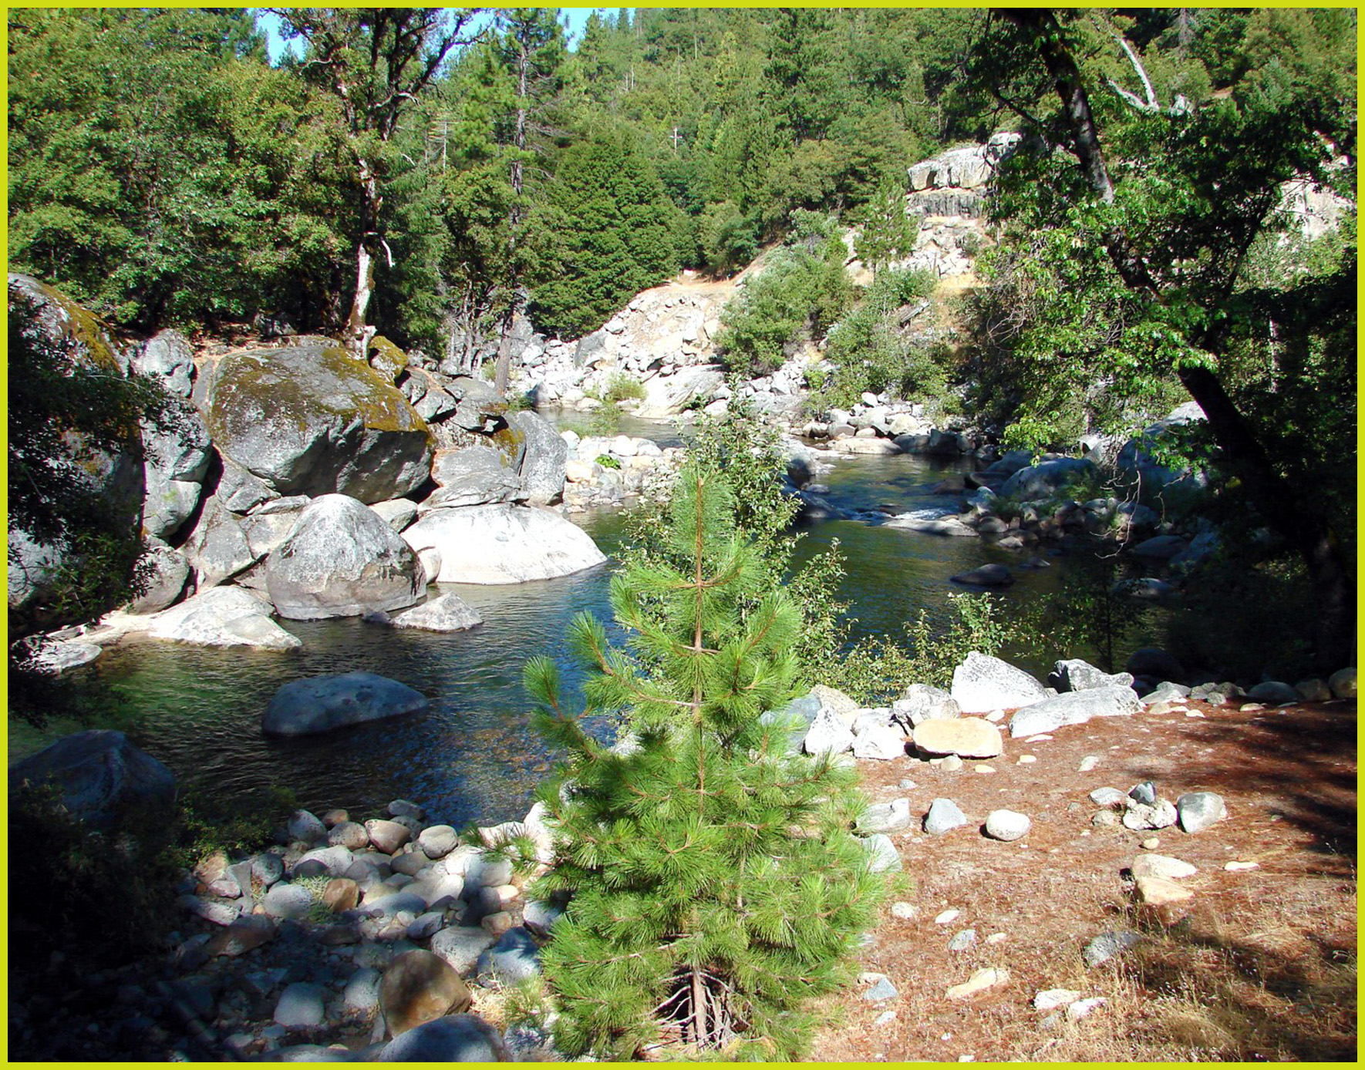

Slide 3
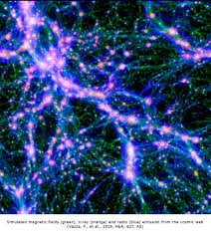
Notes:
Dark matter pathways – George Smoot

Slide 4
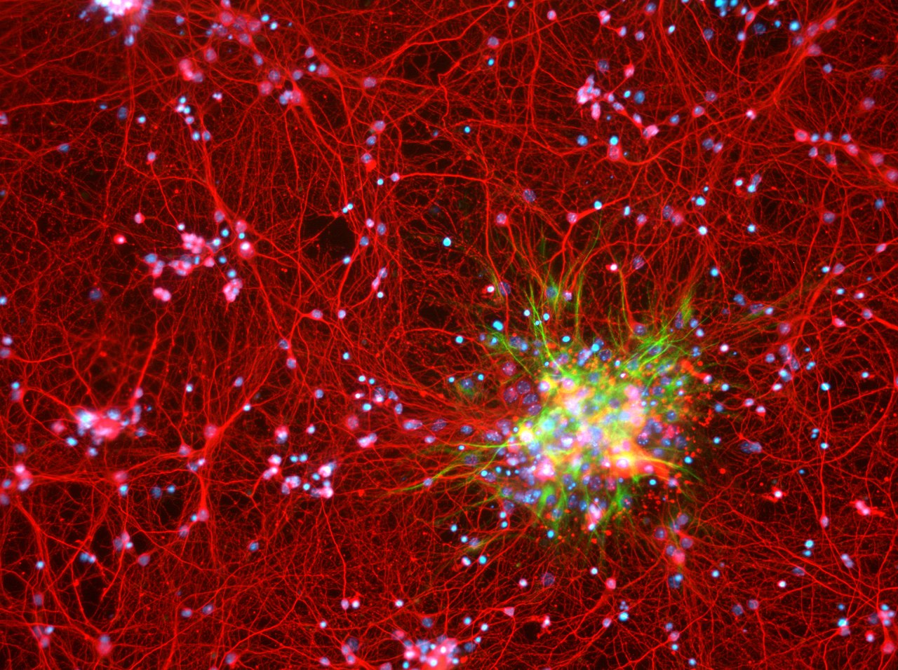
Notes:
Brain activity

Slide 5

Notes:
Sound wave

Slide 6
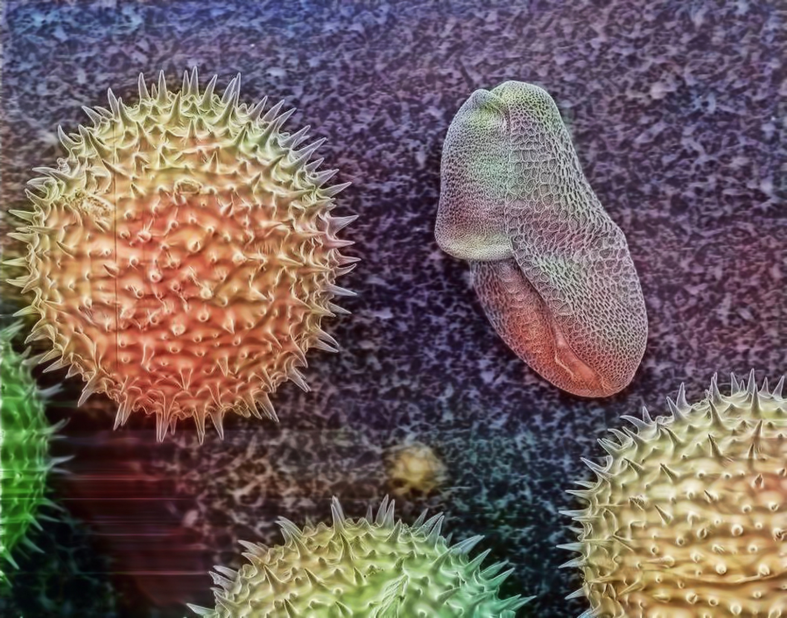
Notes:
Pollen

Slide 7
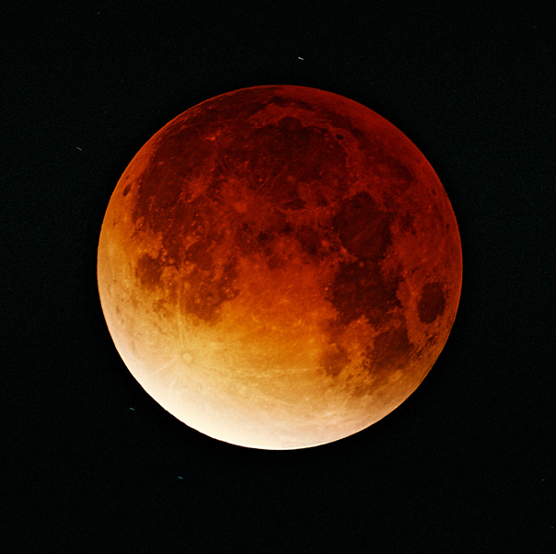
Notes:
Moon

Slide 8
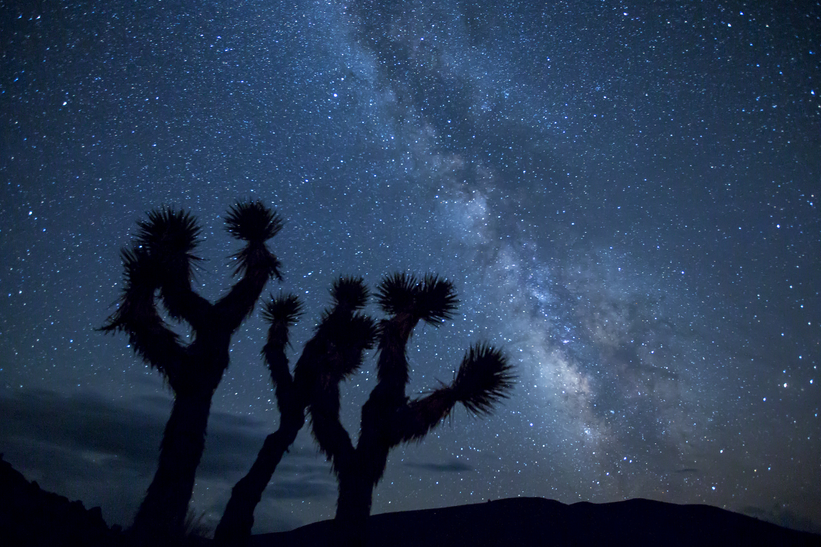
Notes:
Milky Way

Slide 9
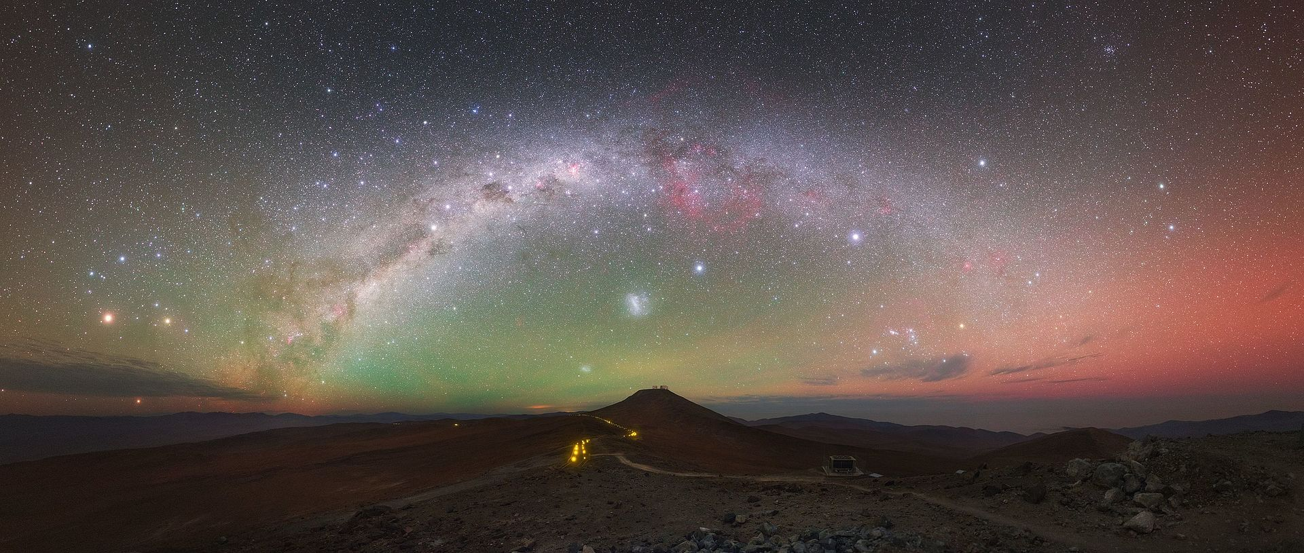
Notes:
Paranal Observatory – Northern Chile

Slide 10
Is there a connection between Science and Theology???

Slide 11
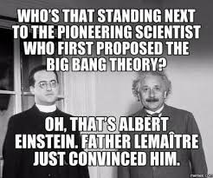
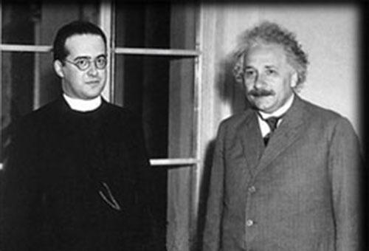
THINK ABOUT IT AND BE HONEST
What has the Church done to support or suppress science?
Notes:
Create a list on the board of student responses – do not correct or comment – simply record

